Slide 1

The car wash case
and the future of
anti-corruption EFFORTS in brazil
Deltan Martinazzo Dallagnol
Leading Federal Prosecutor
Lava Jato Task Force
Federal Prosecution Service – Brazil
Harvard University
Boston, MA – April/2016

Slide 2
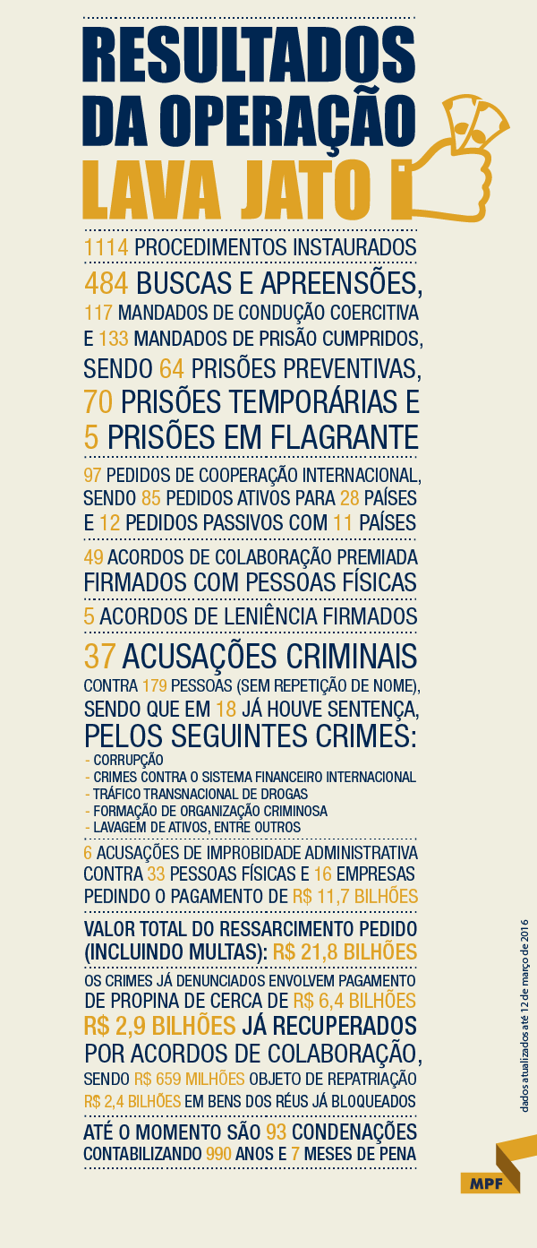

Slide 3
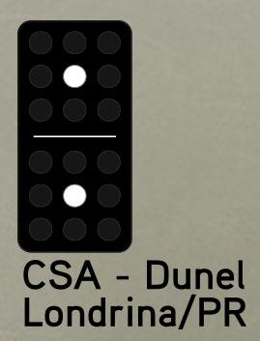
CAR WASH INVESTIGATION the originS 2009

Slide 4
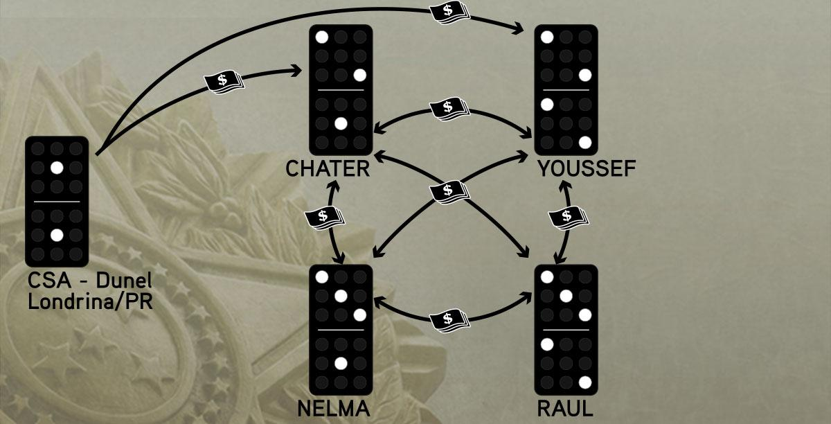
Lava jato task force
1ST PHase 17-20/marCH/2014

Slide 5
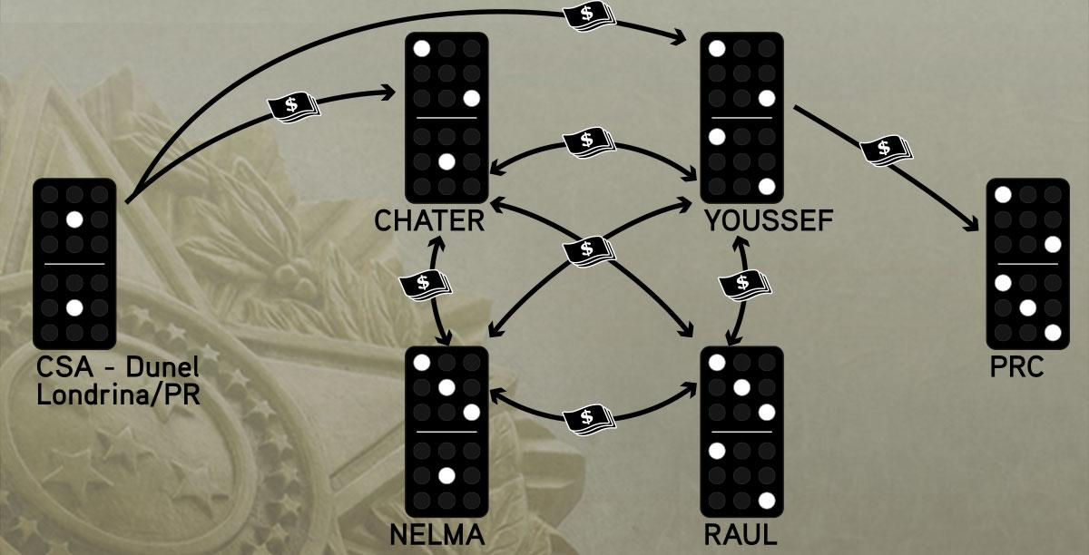
Lava jato TASK FORCE
1ST PHase 17-20/MARCH/2014

Slide 6
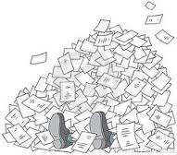
fOLLOW THE MONEY?
Tens of Terabytes of Data
Financial Operators and Hawala Dealers (“doleiros”)
Money comes from different sources
A certain amount leaves the pile
Whose money is it anyway?
Cash operations and compensations

Slide 7
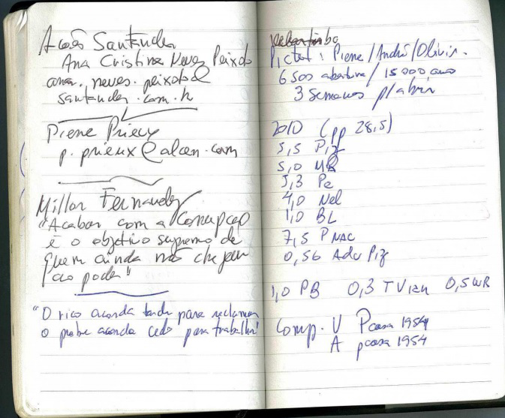
CHALLENGES:
DECIPHER WITH NO HINDSIGHT PRIVILEGE
IDENTIFY REASONS AND MEANS OF PAYMENTS
PRODUCE EVIDENCE

Slide 8

Há vagas para cripto-analistas...
João Alberto Pizzolati Jr.
Adv. De Pizzolati
Mario Negromonte
Pedro Correa
Nelson Meurer
Benedito Lira
??
Paulo Bernardo
Tião Viana
Valdir (“W”) Raupp

Slide 9

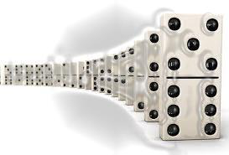
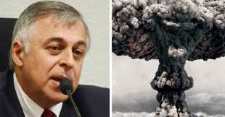
COOPERATION AGREEMENTS
- DOMINO EFFECT -

Slide 10
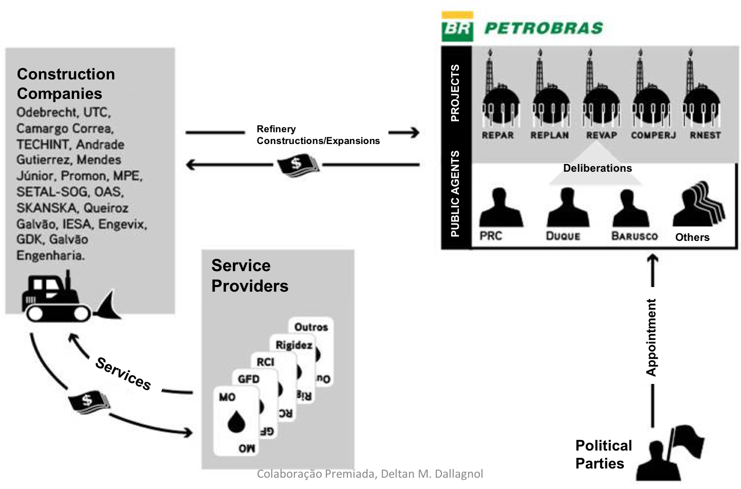
MONEY Fluxogram (RELATED TO)
HUGE oil PLANTS OF Petrobras

Slide 11
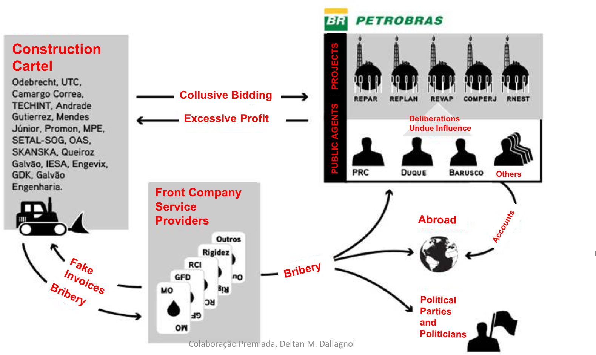
ILLICIT MONEY Fluxogram (RELATED TO)
HUGE oil PLANTS OF Petrobras

Slide 12
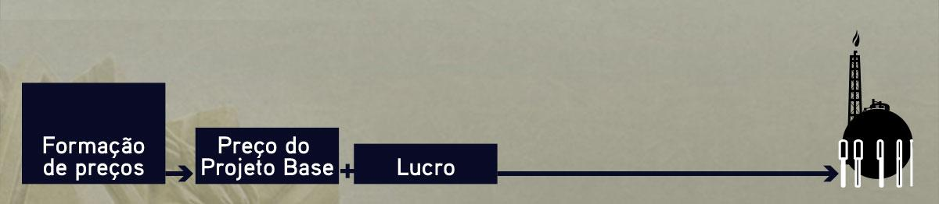
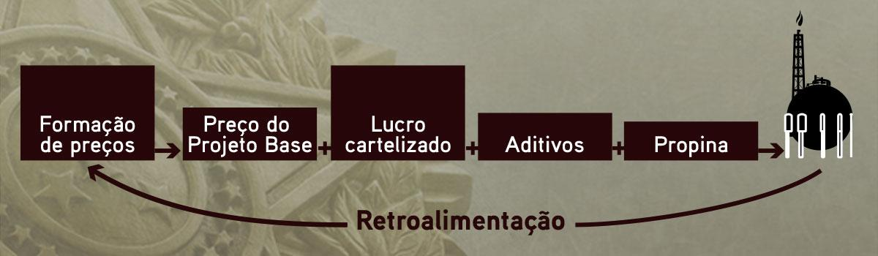
The COST of an oil plant
Price calculation
Price of basic project
Profit
Price calculation
(considering previous prices)
Price of basic project
Overprices
Additives
Bribes

Slide 13

Sharing PROFITS
60%
20%
14%
POLITICAL PARTIES AND POLITICIANS
6%
EXPENSES (INCLUDING TAXES)
PETROBRAS AGENTS
INTERMEDIARIES

Slide 14
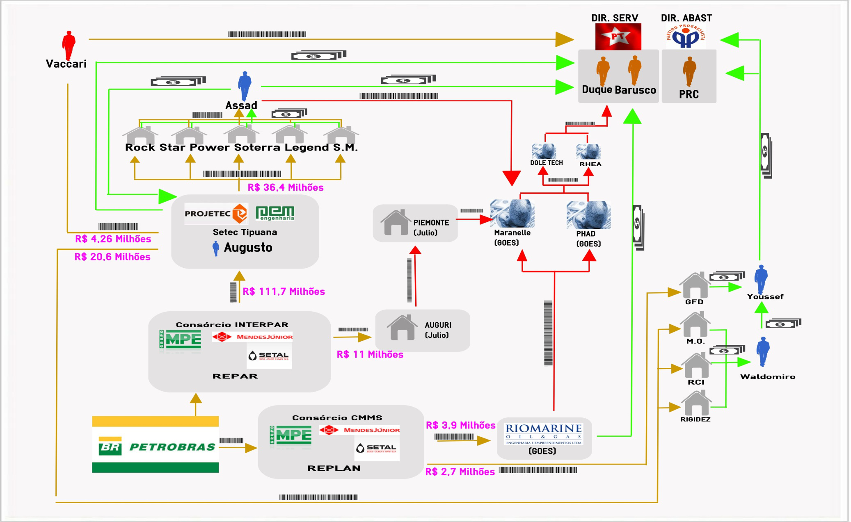
Money fluxogram repar / replan

Slide 15
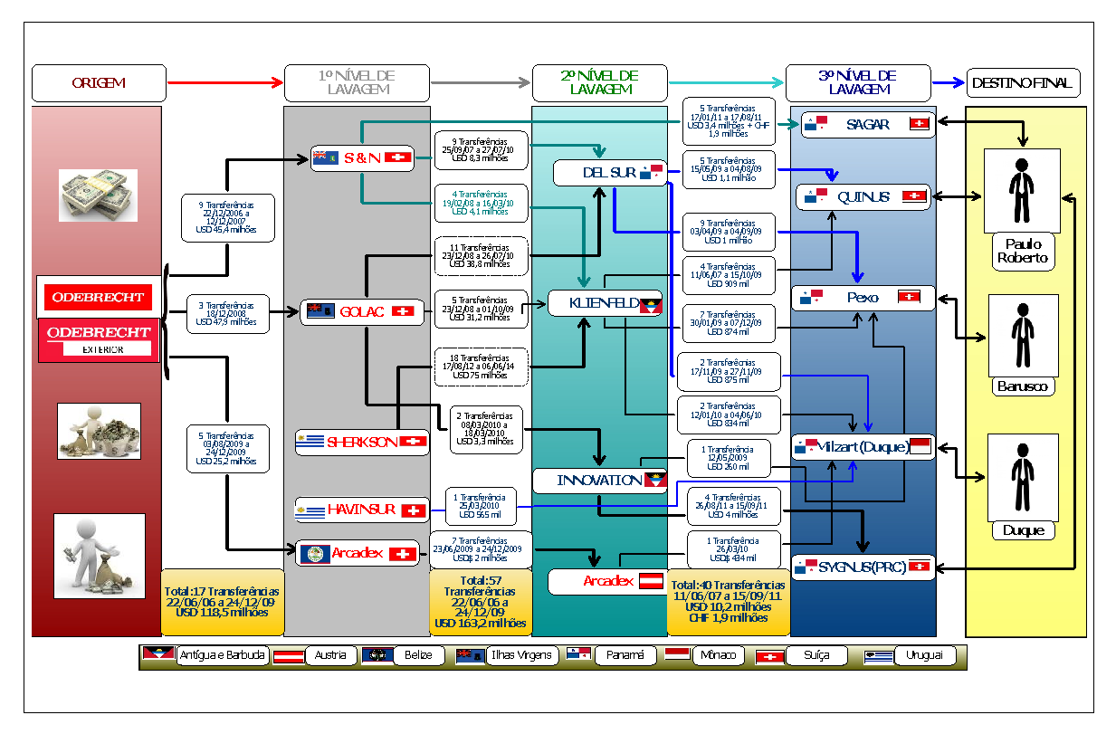
International laundering

Slide 16
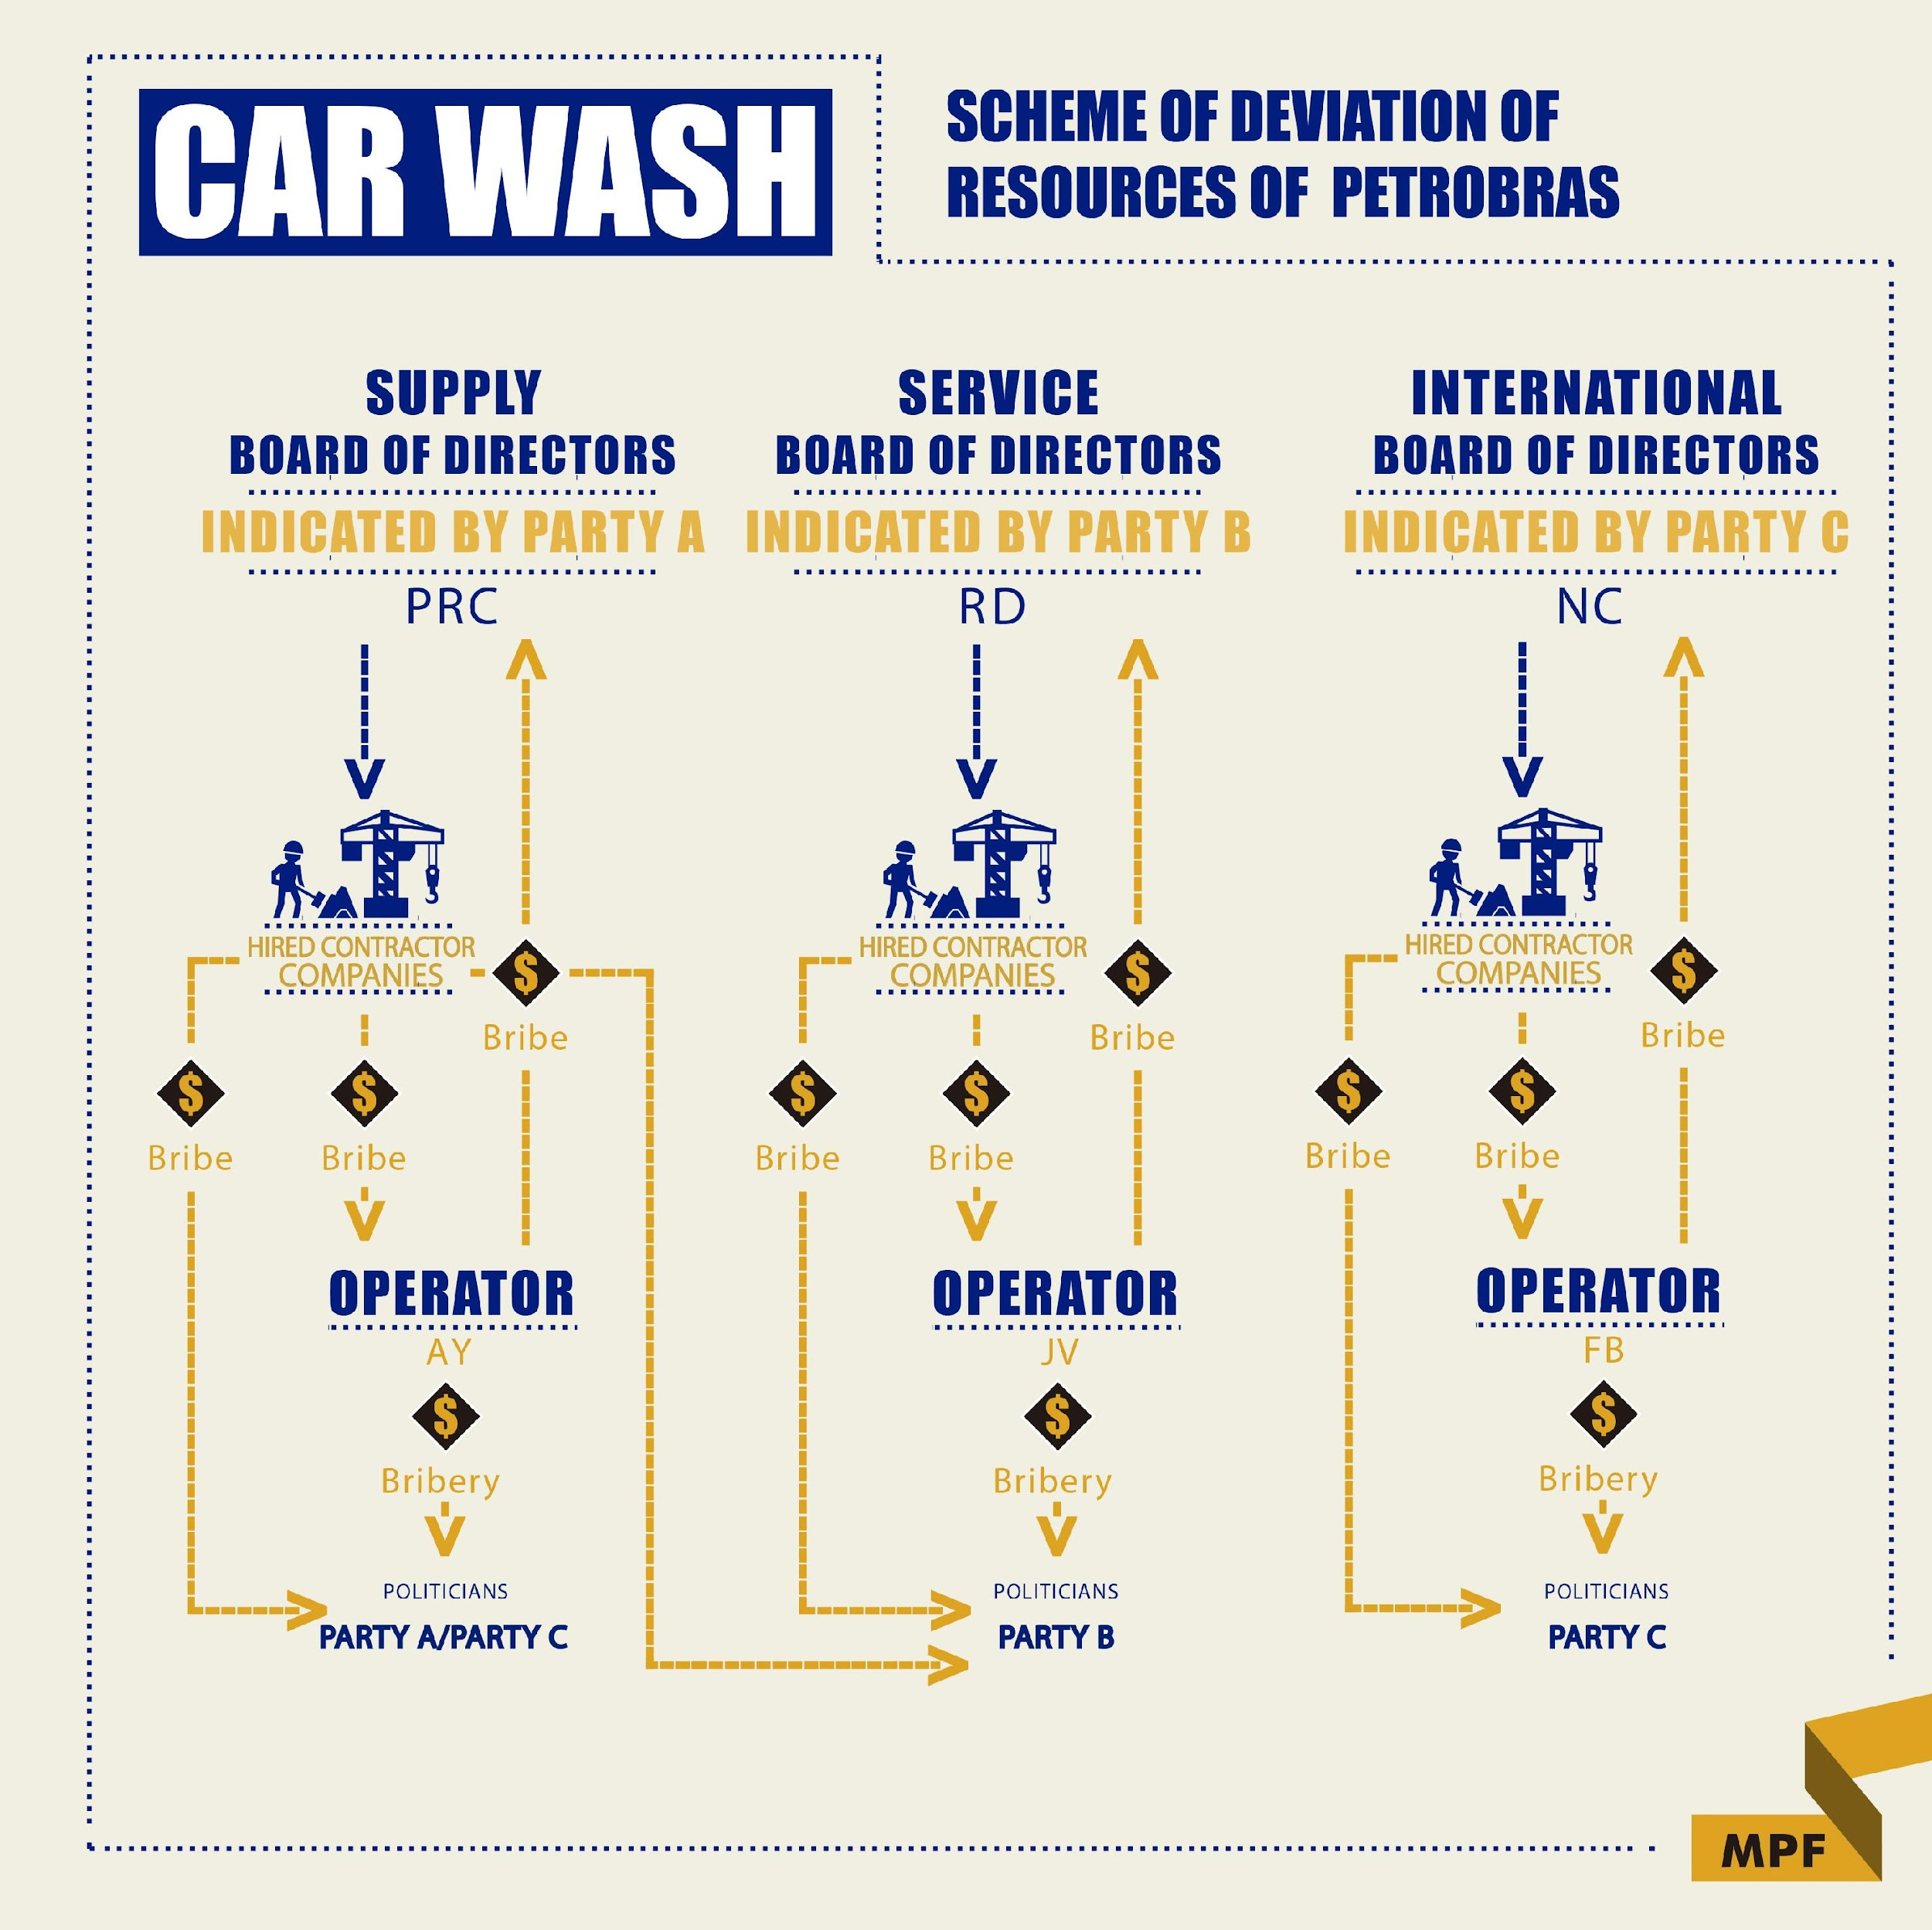

Slide 17
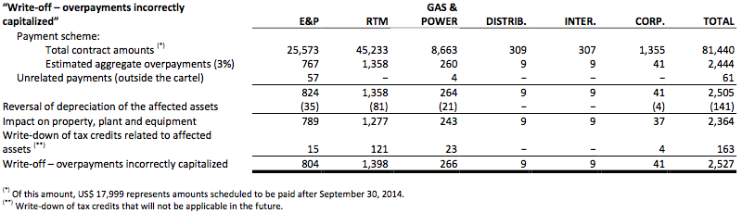

Corruption estimateS
US$ 2.1 billion
(3% of projects)
US$ 8 million

Slide 18
THE TRUE criminal SCHeMe...
EXECUTIVE POWER (PRESIDENT CABINET)
“Presidentialism of coalition”
Approval of bills (deference)
CONGRESS
“Allied base”
“Governability”
Deference as to political appointments
Value of appointments = bribes
Electoral financing ($$$)
Illegal enrichment
...
Petrobras
Eletrobras
Planning Ministry
Health Ministry
Federal Savings Bank

Slide 19
Fruits of international cooperation
US$ 300 mi
  Assets frozen abroad
US$ 150 mi
  Recovered in the Car Wash case
US$ 15 mi
  Recovered before the Car Wash case

Slide 20
Myths – UNDUE PROCESS?
ARRESTS TO FORCE COOPERATION?
JUDICIAL MISCONDUCT?

Slide 21
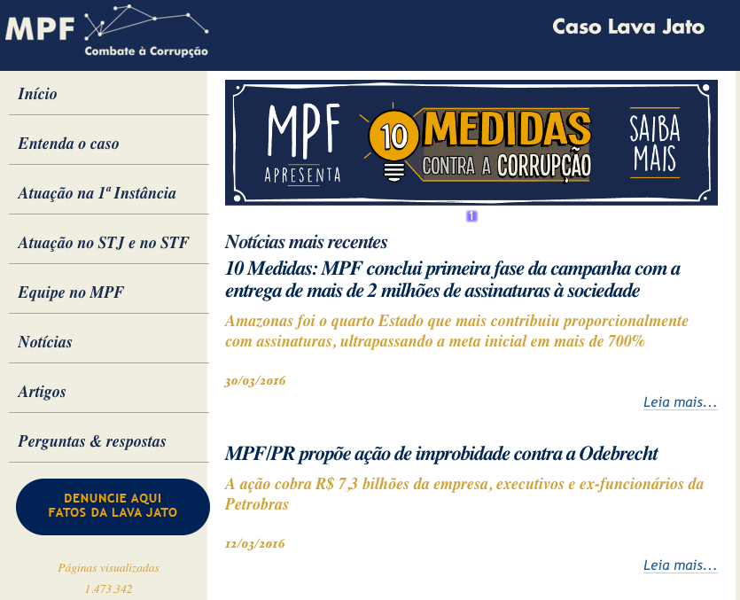
TRANSPARENCY of the case
Notes:
‹#›

Slide 22
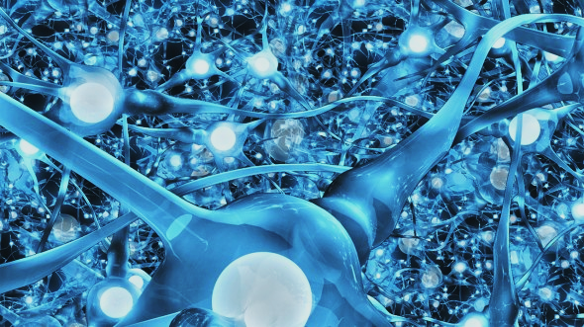
CAR WASH CASE WILL NOT CHANGE BRAZIL
We must not adopt the rotten apple theory

Slide 23
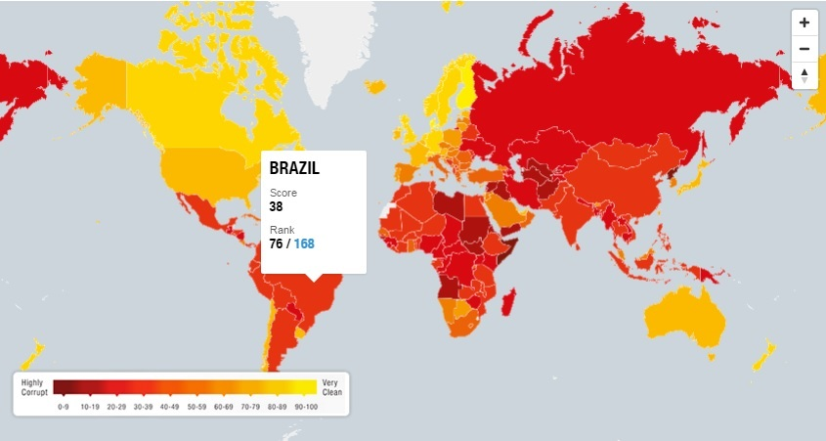
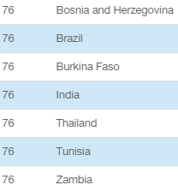


Slide 24
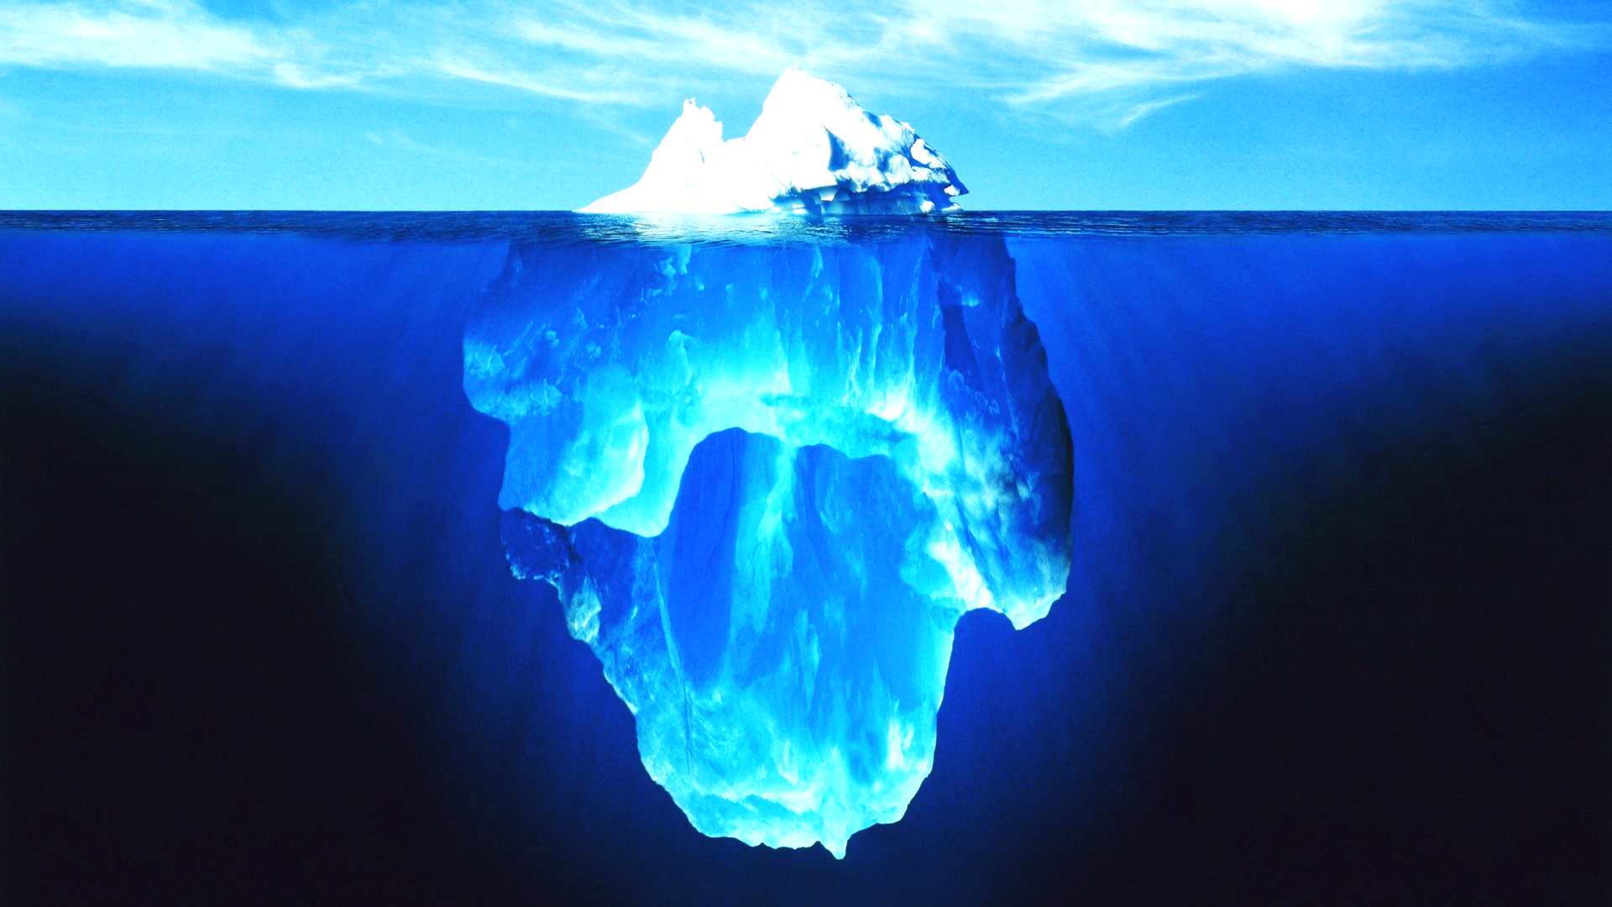
US$ 2.1 BI
?

Slide 25

US$ 70 bi

Slide 26
Rose Ackerman’s proposals in “Corruption: greed, culture and the State” (2010)
1) Simple transparency
2) External oversight of government activity
3) Transparent and competitive processes for large-scale procurement
4) Enforcement of bribery laws
5) Functional complaints system
6) Reform of electoral law (if political corruption is pervasive)
MAIN PROBLEMS

Slide 27
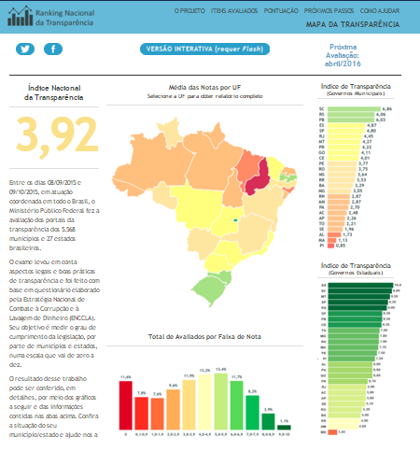
Federal Prosecution project to improve transparency

Slide 28
Political Reform
Change of the coalition system
Legal persons electoral donations
System of proportional representation
Number of political parties
Number of candidates
Very expensive campaigns
Brazilian Bar Association:
Semi-Presidentialism Reform
Democratic Political Reform (*Ficha limpa, CNBB)
http://www.reformapoliticademocratica.org.br/

Slide 29

JUSTICE SYSTEM REFORM: Brazi is the impunity heaven for corupters and corruptees
DISCOVER
PROVE
NOT NULLIFY
DELAY
STATUTE OF LIMITATIONS
EXECUTION
LOW PENALTIES
PARDON AFTER 1/4

Slide 30
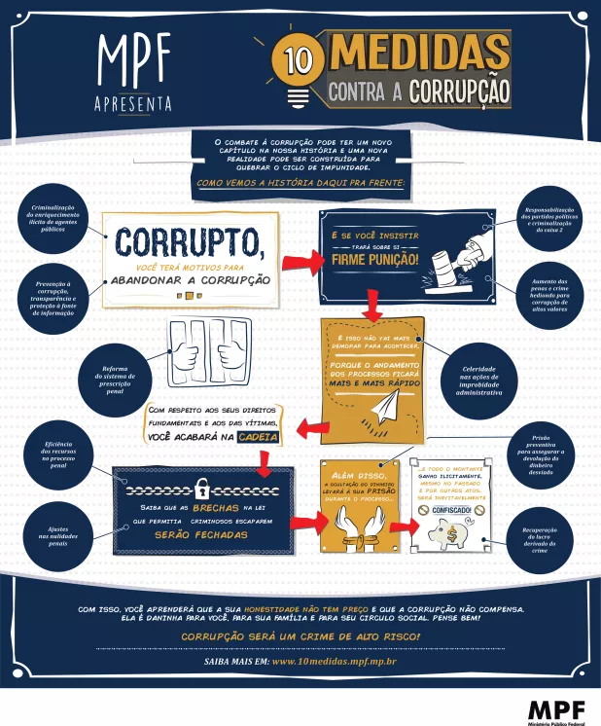
Small
Changes
Make
BIG
Differences
=> Rational Choice Theory

Slide 31
PROPORTIONATE
PUNISHMENT
-
END OF IMPUNITY
(3%)
PREVENTION
ASSETS
RECOVERY
20 bills
Non-corporative
Inspiration in the Hong Kong case

Slide 32
Legislative proposals

Slide 33
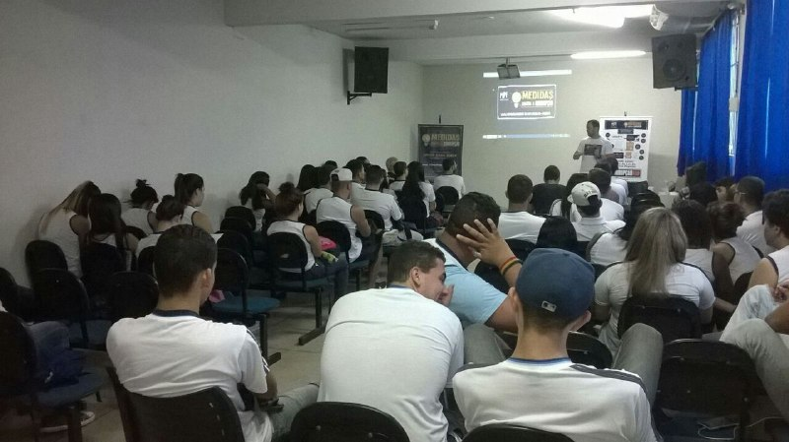
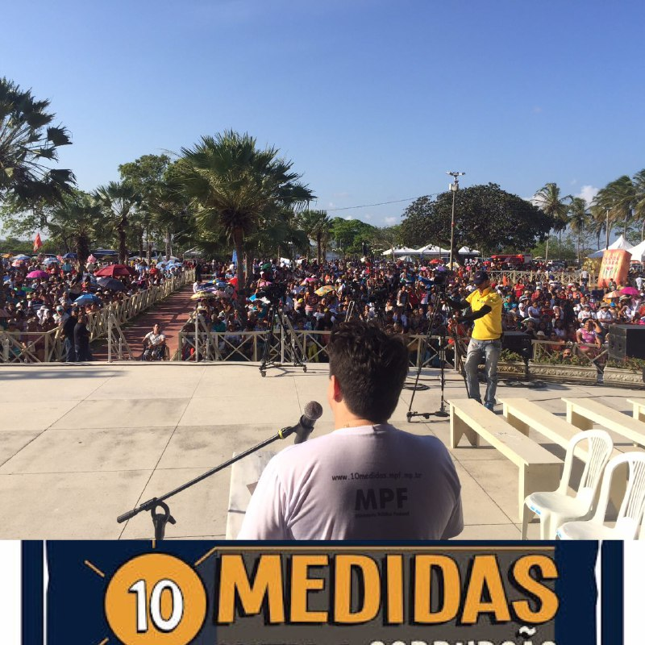
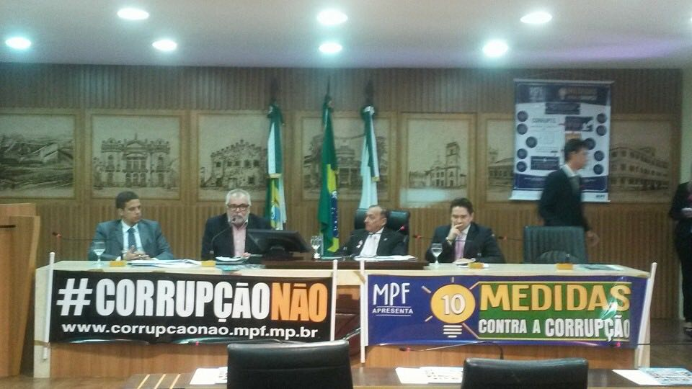
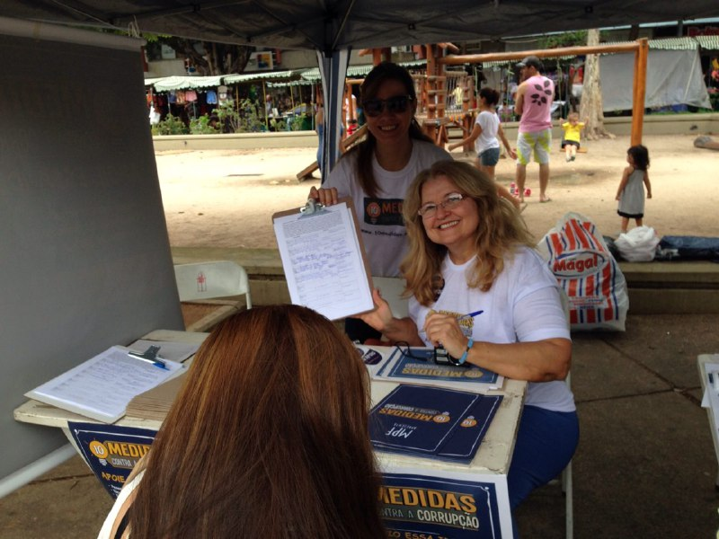
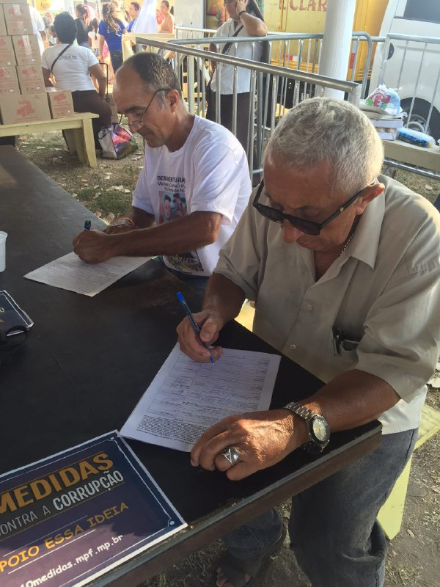
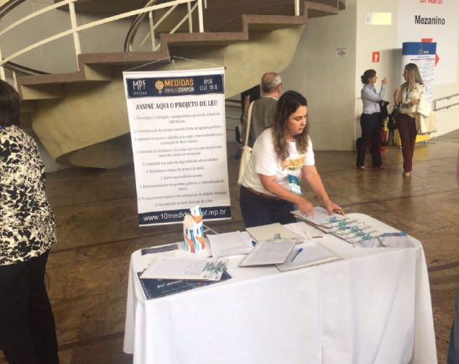
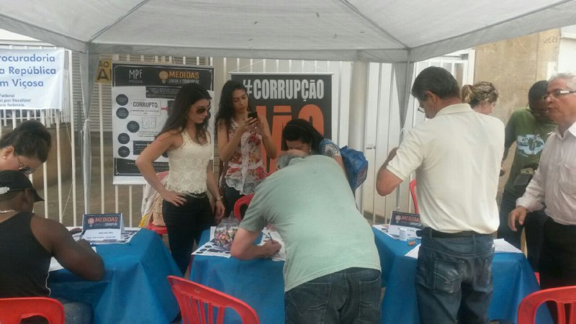

Slide 34
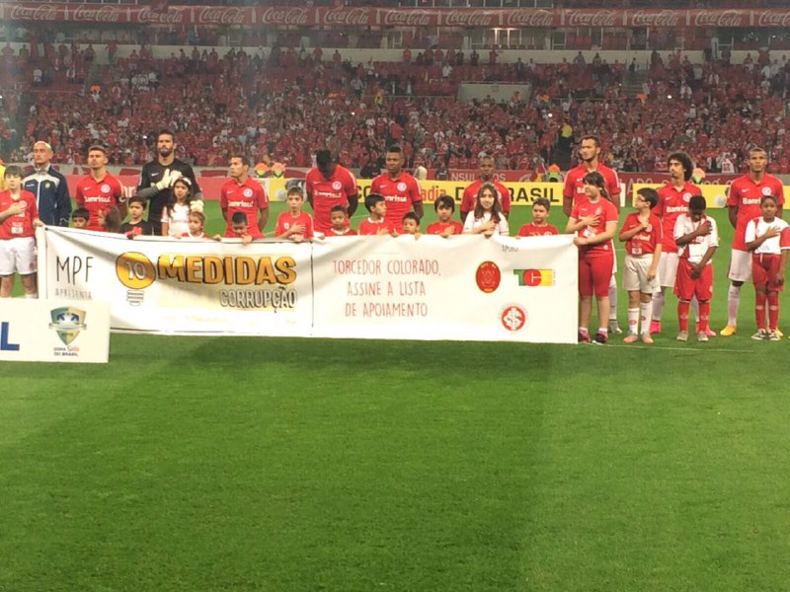
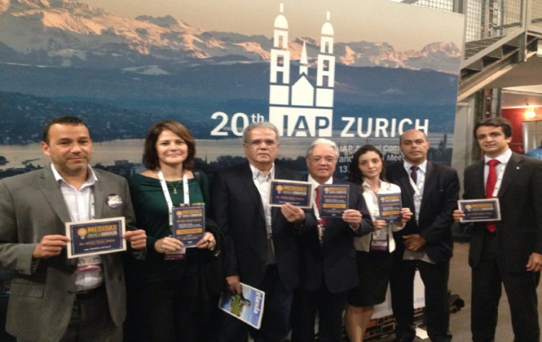
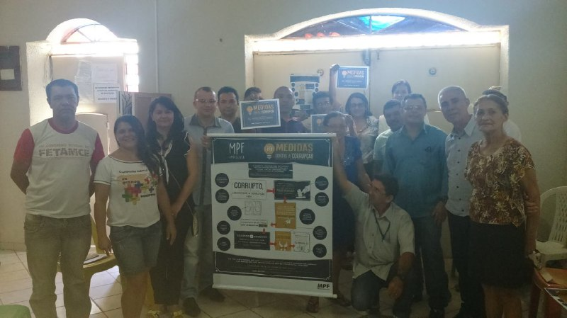
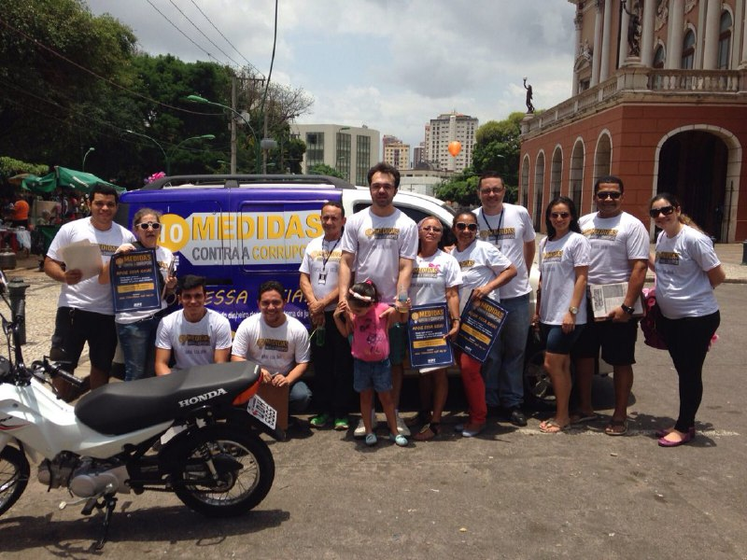
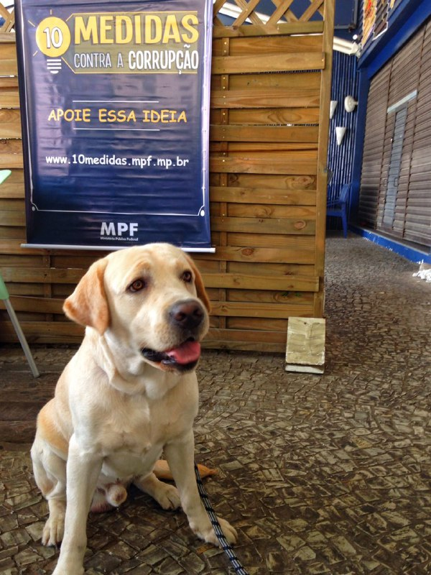
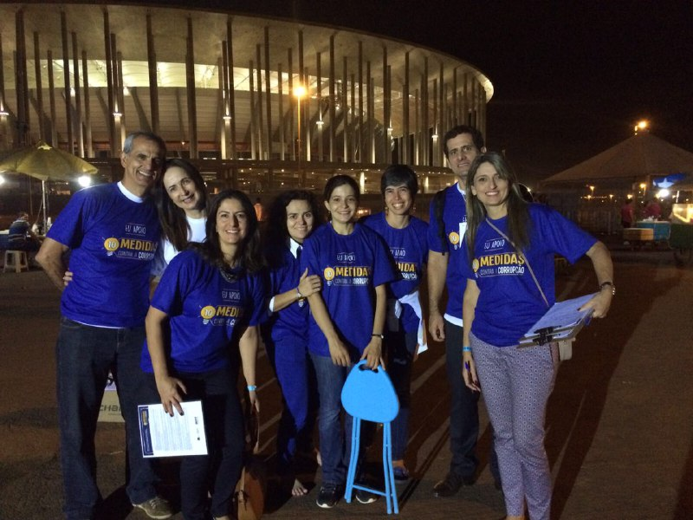
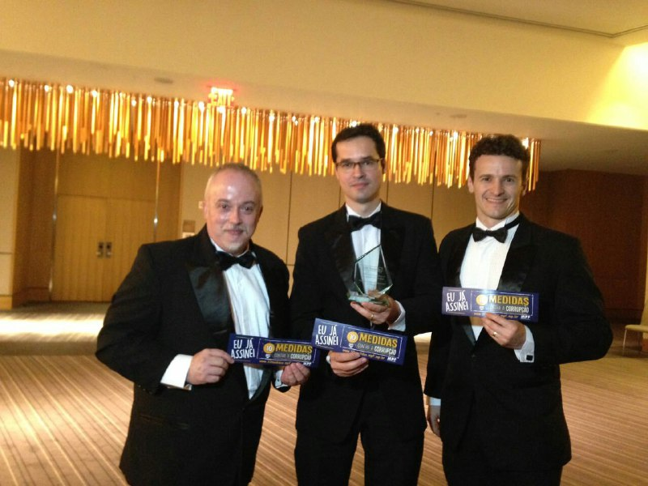
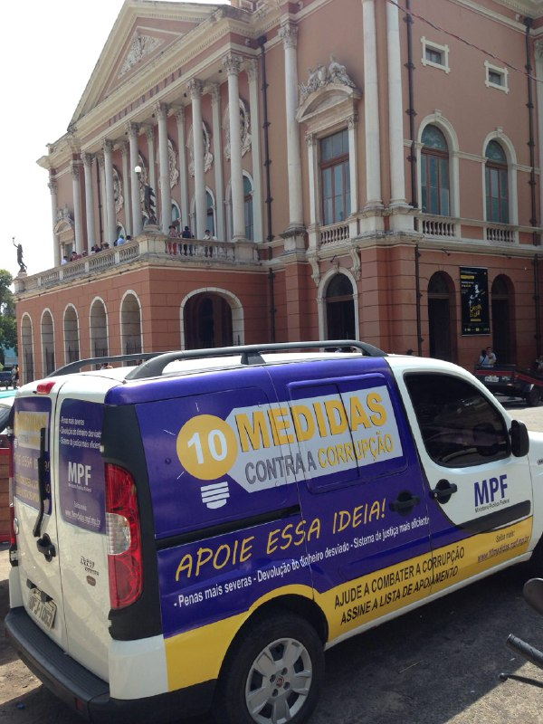
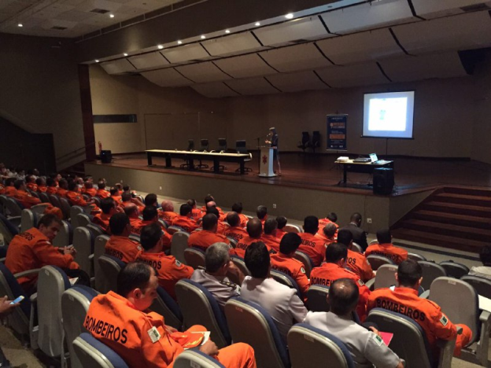

Slide 35
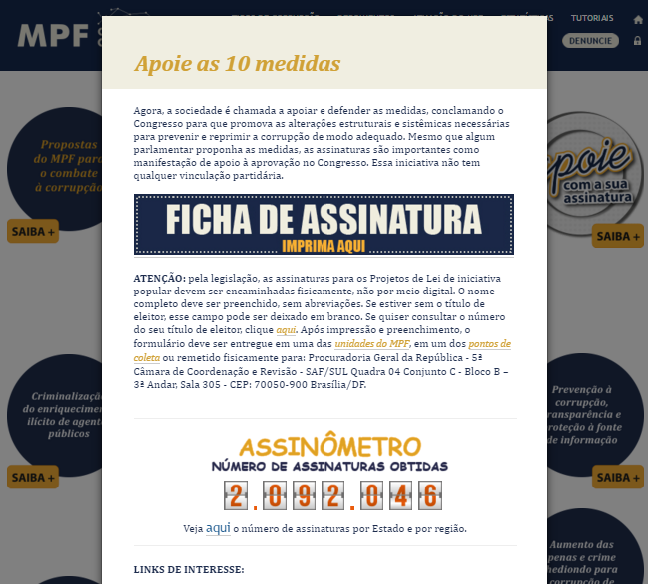

Slide 36
THANK YOU
Deltan Martinazzo Dallagnol
Federal Prosecutor
Maria Maíria Leite Carlos
mariacarlos@mpf.mp.br

